Slide 1

ENGINEERING MATHEMATICS-I
MATLAB
Department of Science and Humanities

Slide 2

Grams- Schmidt in 9 Lines of MATLAB.
The Gram-Schmidt algorithm starts with n independent vectors a1,….,an (the columns of A). It produces n orthonormal vectors q1,…,qn (the columns of Q). To find qj, start with aj and subtract off its projections onto the previous q’s and then divide by the length of that vector v to produce a unit vector.
The inner products (qi )T aj =0 when i is larger than j (later q’s are orthogonal to earlier a’s, that is the point of the algorithm).

Slide 3

Grams- Schmidt in 9 Lines of MATLAB.
Here is a 9-line MATLAB code to build Q and R from A. Start with [m,n]=size(A); Q=zeros(m,n); R=zeros(n,n);to get the shapes correct.
>> for j=1:n % Grams-Schmidt orthogonalization
>> v=A(: , j); % v begins as column j of A
>> for i=1:j-1
>> R(i,j)=Q(:,i)’*A(:,j); % modify A(:,j) to v for more accuracy
>> v=v-R(i,j)*Q(:,i); % subtract the projection
>> end % v is now perpendicular to all of q1,…qj-1
>> R(j,j)=norm(v);
>> Q(:,j)=v/R(j,j); % normalize v to be the next unit vector qj
>> end

Slide 4
Grams- Schmidt Orthogonalization process continued..
Example:
Apply the Gram-Schmidt process to the vectors (1,0,1), (1,0,0) and (2,1,0) to produce a set of Orthonormal vectors.
>> A=[1,1,2;0,0,1;1,0,0]
>> Q=zeros(3)
>> R=zeros(3)
>> for j=1:3
>> v=A(: , j)
>> for i=1:j-1
>> R(i,j)=Q(:,i)'*A(:,j)
>> v=v-R(i,j)*Q(:,i)
>> end
>> R(j,j)=norm(v)
>> Q(:,j)=v/R(j,j)
>> end

Slide 5
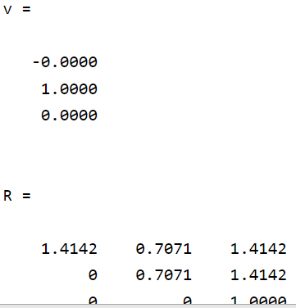
Grams- Schmidt Orthogonalization process continued..
Output:

Slide 6
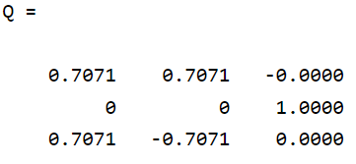
Grams- Schmidt Orthogonalization process continued..
.Output:

Slide 7
Grams- Schmidt Orthogonalization process continued..
2. Apply the Gram-Schmidt process to the vectors a=(0,1,1,1),
b=(1,1,-1,0) and c=(1,0,2,-1).
>> A=[0,1,1;1,1,0;1,-1,2;1,0,-1]
>> Q=zeros(4,3)
>> R=zeros(3)
>> for j=1:3
>> v=A(: , j);
>> For i=1:j-1
>> R(i,j)=Q(:,i)'*A(:,j)
>> v=v-R(i,j)*Q(:,i)
>> end
>> R(j,j)=norm(v)
>> Q(:,j)=v/R(j,j)
>> end
.

Slide 8
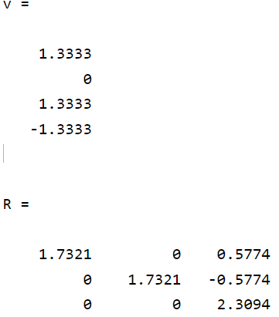
Grams- Schmidt Orthogonalization process continued.. Output:

Slide 9
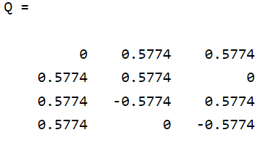
Grams- Schmidt Orthogonalization process continued..

Slide 10
THANK YOU

